Slide 1
CSE 125 Survival Guide
Thinh Nguyen
Spring 2014

Slide 2
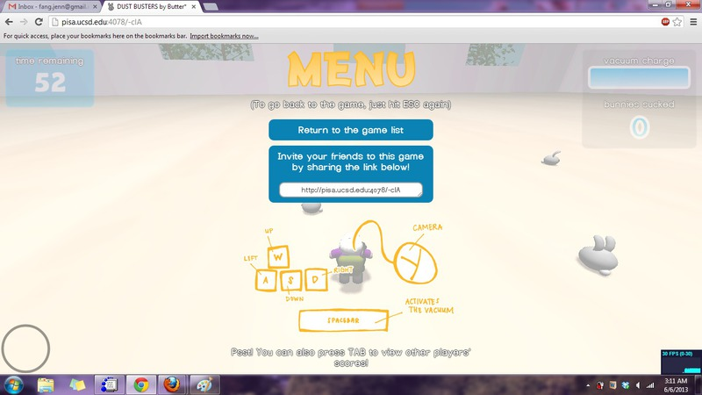
About Me
Thinh Nguyen
5th year undergrad
Email : thn024@ucsd.edu
Dustbusters – Spring 2013

Slide 3
What is this class?
CSE 125 is hard~
Potentially the most intensive undergrad CSE course
You get what you put into it
There is always something you can do for any given day
No such thing as being “finished”
Collective effort
No base code, no right or wrong answers, open ended
Creative and academic freedom
Real world experience

Slide 4
Starting line
Brainstorm ideas!
Come up with several ideas, collectively decide on what to make together
Think about player interactions
Cooperative vs Competitive game, scoring system, gameplay genre
Art style
Cartoony/realistic, 1st/3rd person, open/closed environment
Be reasonable
15 minute demo
Ease of development

Slide 5
Iterative Development
Get the core elements of the game up ASAP
Start off with the basics and work your way up
Render a simple primitive
Network two clients
Camera movements/controls
Load your basic model (placeholder graphics)
Move your model
Play music
After you’re done with the core necessities, go crazy with effects
Particle systems, different lighting models, basic AI, menus, Post processing effects, animations, etc.
Start with the simple DirectX/OpenGL samples

Slide 6
Working
Work and compile locally, store remotely
Update, edit/compile, … , update, commit
Work in the labs
Pair programming, accompaniment, code-a-thons
Get things done during meetings
Discuss plans for the week, schedule code sessions, updates, make it fast and concise
Commit before you leave, commit often
Get used to resolving merge conflicts and using version control
Keep a branch that has stable code, push only working code

Slide 7
Communication!
Hang out with your team
Not just in the labs…
Talk with other teams/me/Voelker
Everyone’s in this together, not a competition
Play the game, hopefully enjoy it
Split up the tasks, have 1 or 2 people in charge of each
Gameplay Logic, Engine, Input, Sound, Animation(?), GUI, Network
Make a schedule, expect delays
Set earlier deadlines, they will get pushed back

Slide 8
Graphics~
DirectX
Windows-only
Standard for several games on PC
A lot of support and examples on the web
Built into Visual Studio 2013 (less reliant on outside libraries)
Does more than just graphics
Better shader management system (can be easier to make fancy effects).
Might have to learn/get used to different quirks of the language (Left handed coordinate system, multiplication order, texture addressing order).

Slide 9
Graphics Cont.
OpenGL
Cross platform
Lots of wrappers for every language
Common for mobile games (OpenGL ES)
Probably have experience via CSE 167
Linux & Mac friendly.

Slide 10
Graphics Cont.
HTML 5 + Javascript (WebGL)
No platform, runs off the web browser.
Everyone can play your game without manually downloading source code.
More difficult, less documentation, asset management
Similar graphics coding to OpenGL
Slower for larger games (should be fine for 15 min demo)
Will need to manage Javascript well (no spagetti code) Something… Different?
Java – LWJGL
Python – through OpenGL wrappers/Pygame

Slide 11
Audio
Lots of sound libraries
DirectSound
SDL
OpenAL
FMOD
Tons of free sound effects on the web

Slide 12
Config Files
Useful so you don’t need to recompile all the time
Health, damage, speed, timing, Network ports/addresses, etc.
Game controls (keyboard mappings), camera controls (FOV),
Path to media content (models, textures, sounds)
Linking textures to models
Parameterizing particle effects
Use XML (maybe TinyXML)
Use a hotkey to reload config files on the fly.

Slide 13
Protips
Use vertex buffers for speed
Particle Systems make things look fancy
Pass by reference
Use meaningful names for everything
Use meaningful comments for everything
Decide on interfaces early
Frontload memory allocation, don’t allocate/dealloc during the game, destroy at the end
Whenever you find yourself needing to allocate memory, code the deallocation part first
Be extremely careful if you must allocate memory during game loop

Slide 14
Finishing Words
Start your project spec on Google Docs
Tons of resources online and on the course website for tutorials on every aspect
graphics, collisions, game logic, asset management, etc.
Resolve problems quickly, don’t put them off
Talk to other group members, other groups, me, Voelker
Don’t be afraid of trying something new!
Have fun working on it, playing it, and hanging out with your group!
Good Luck~

