Slide 1
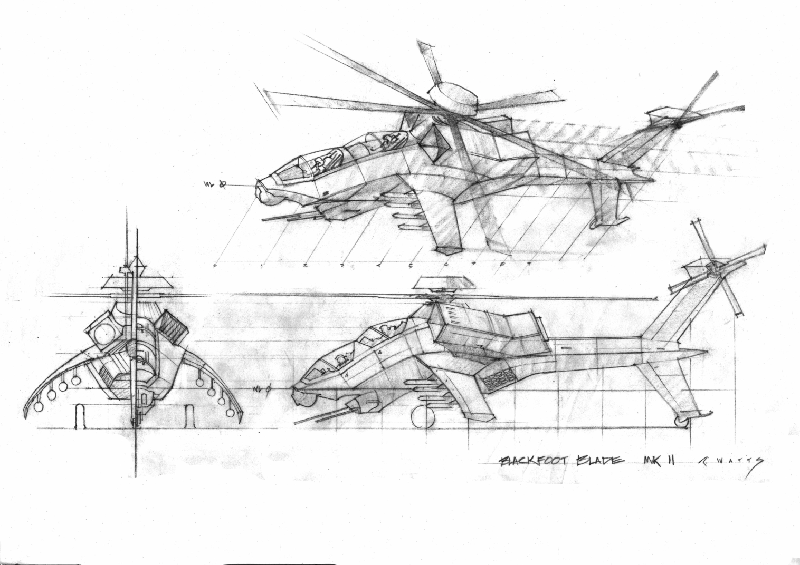
Blackfoot Blade
Confetti Games

Slide 2
Confetti
Think-Tank for game and movie related industries
Middleware Provider
Aura – Dynamic Global Illumination System
PixelPuzzle – PostFX pipeline
Ephemeris – Dynamic Skydome system -> License comes with full source-code
Services:
Hardware vendors
many game developers (“Engine Tuner”)
Provides software solutions for games, movies and tools for GPU manufacturers
http://www.conffx.com

Slide 3
Gameplay
Zip through scenic locales in the most advanced helicopter ever built
Fight enemies with exciting and spectacular weaponry like heat-seeking rockets and machine guns
Single-player gameplay organized into “episodes”, each of which consists of 3 to 5 “levels”, each of which have 2 to 5 minutes of gameplay
Head-to-head and cooperative multiplayer

Slide 4
Target Group
Core-casual gamers playing on tablets/mobile devices
Fans of classic action games like Comanche and Gunship
Fans of shows and movies like Airwolf, Knight Rider, Transformers and Star Wars

Slide 5
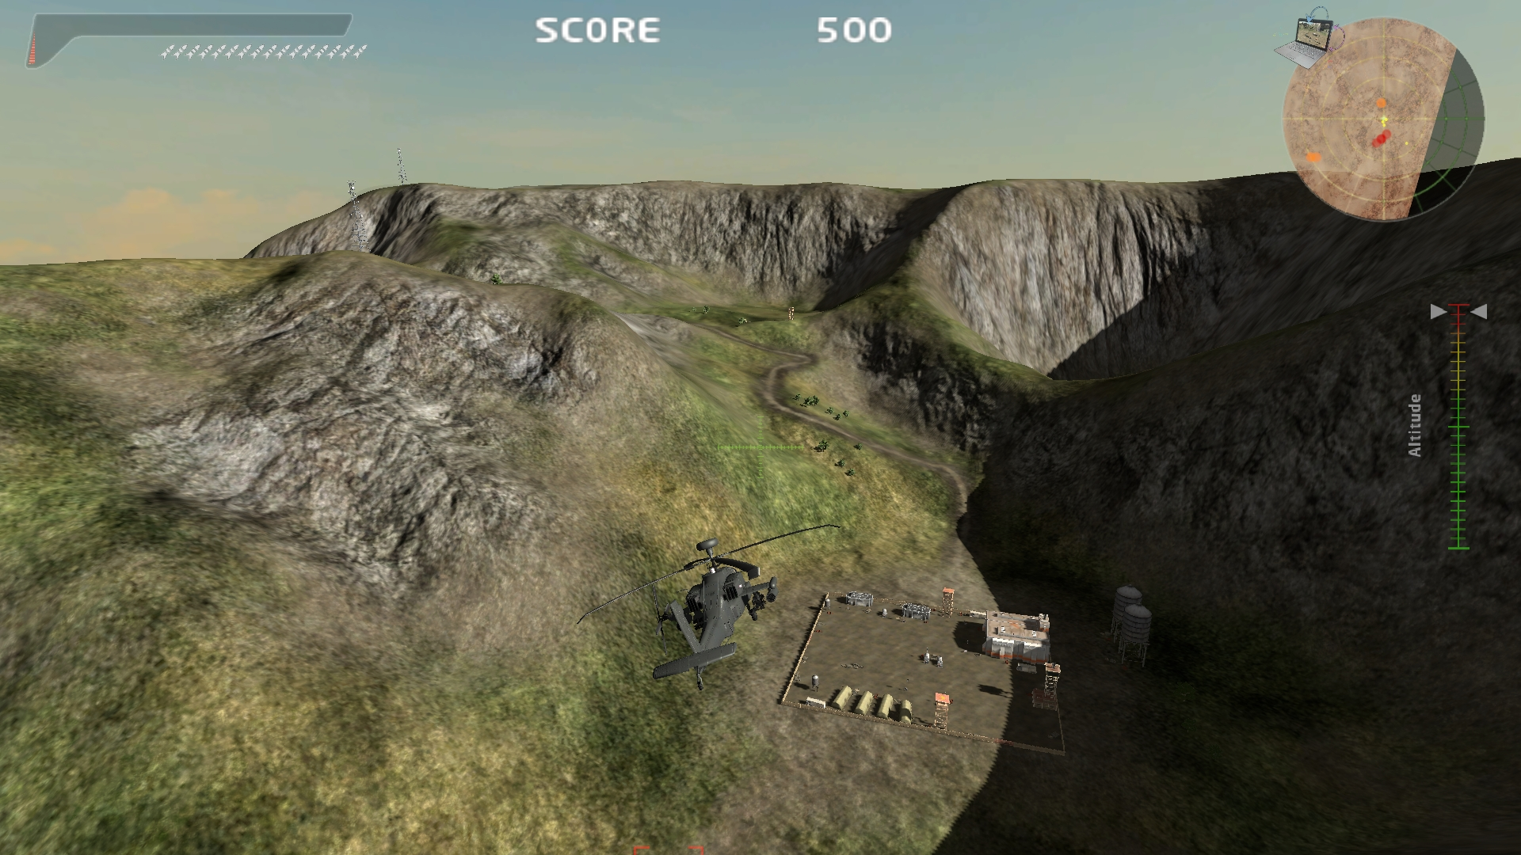
Technology – AAA Graphics Quality

Slide 6
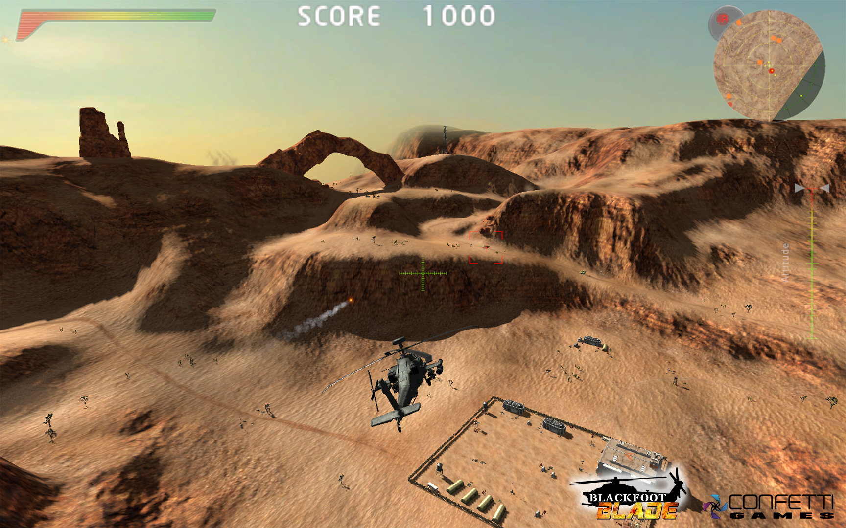
Technology – Advanced Terrain Rendering

Slide 7
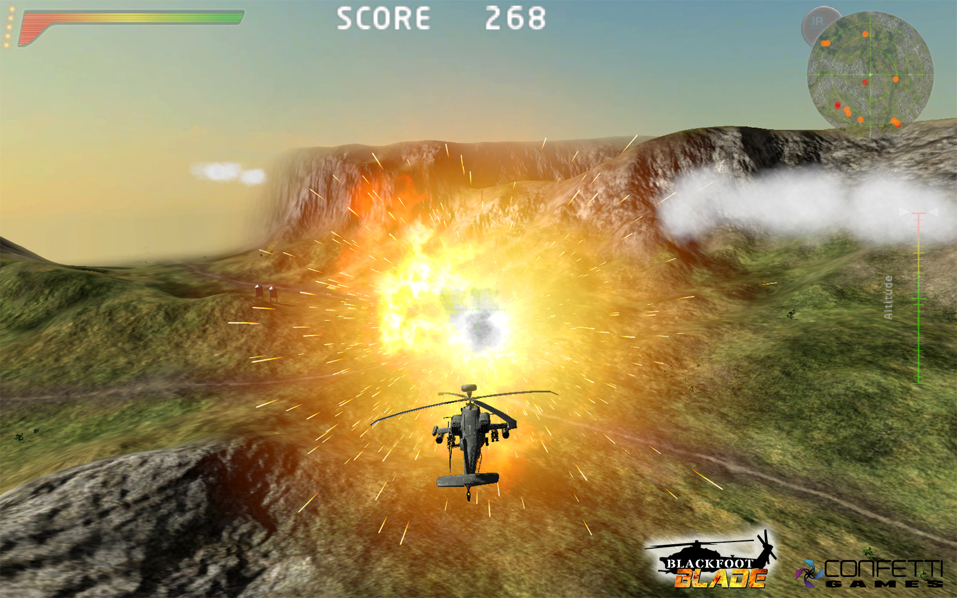
Technology – Cutting Edge Particle System

Slide 8
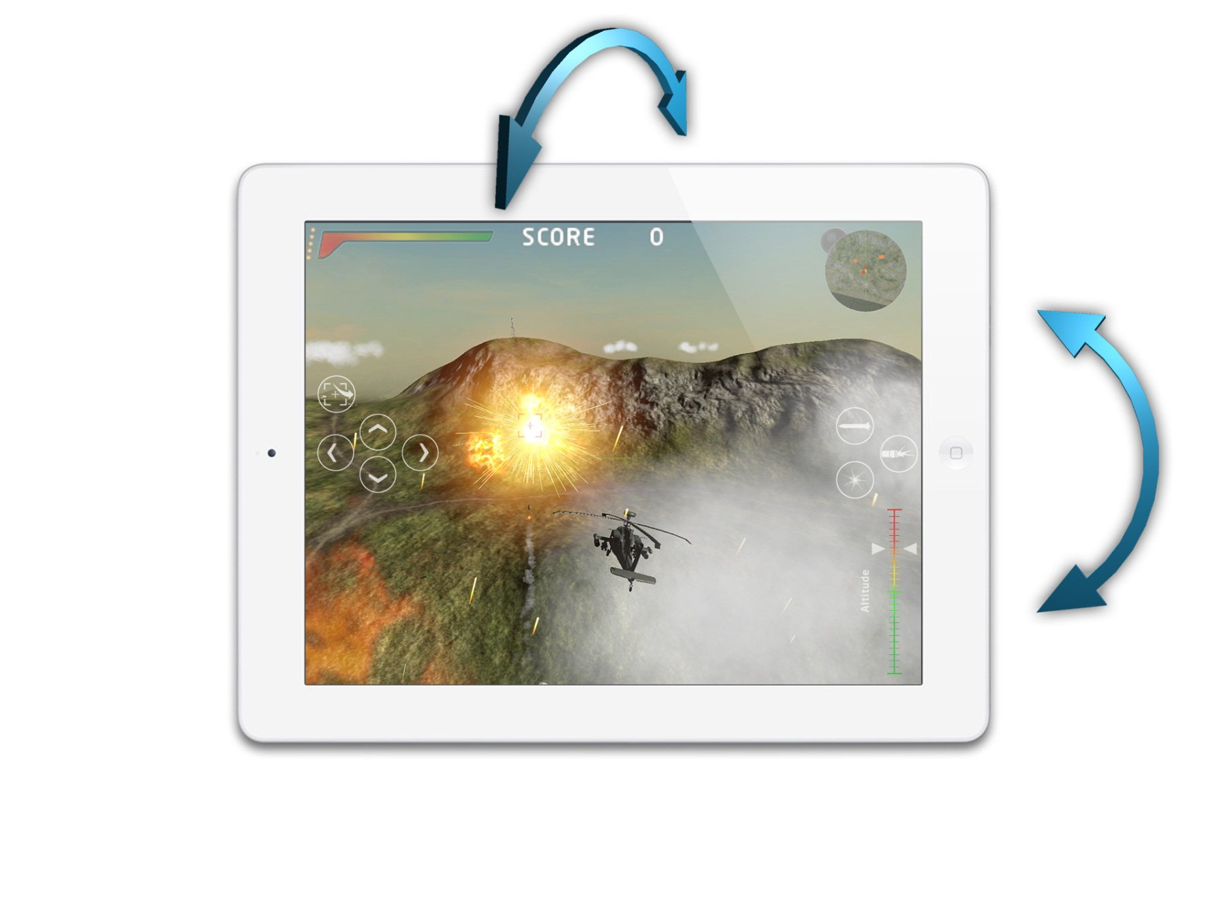
Technology – Touch and Tilt Input

Slide 9
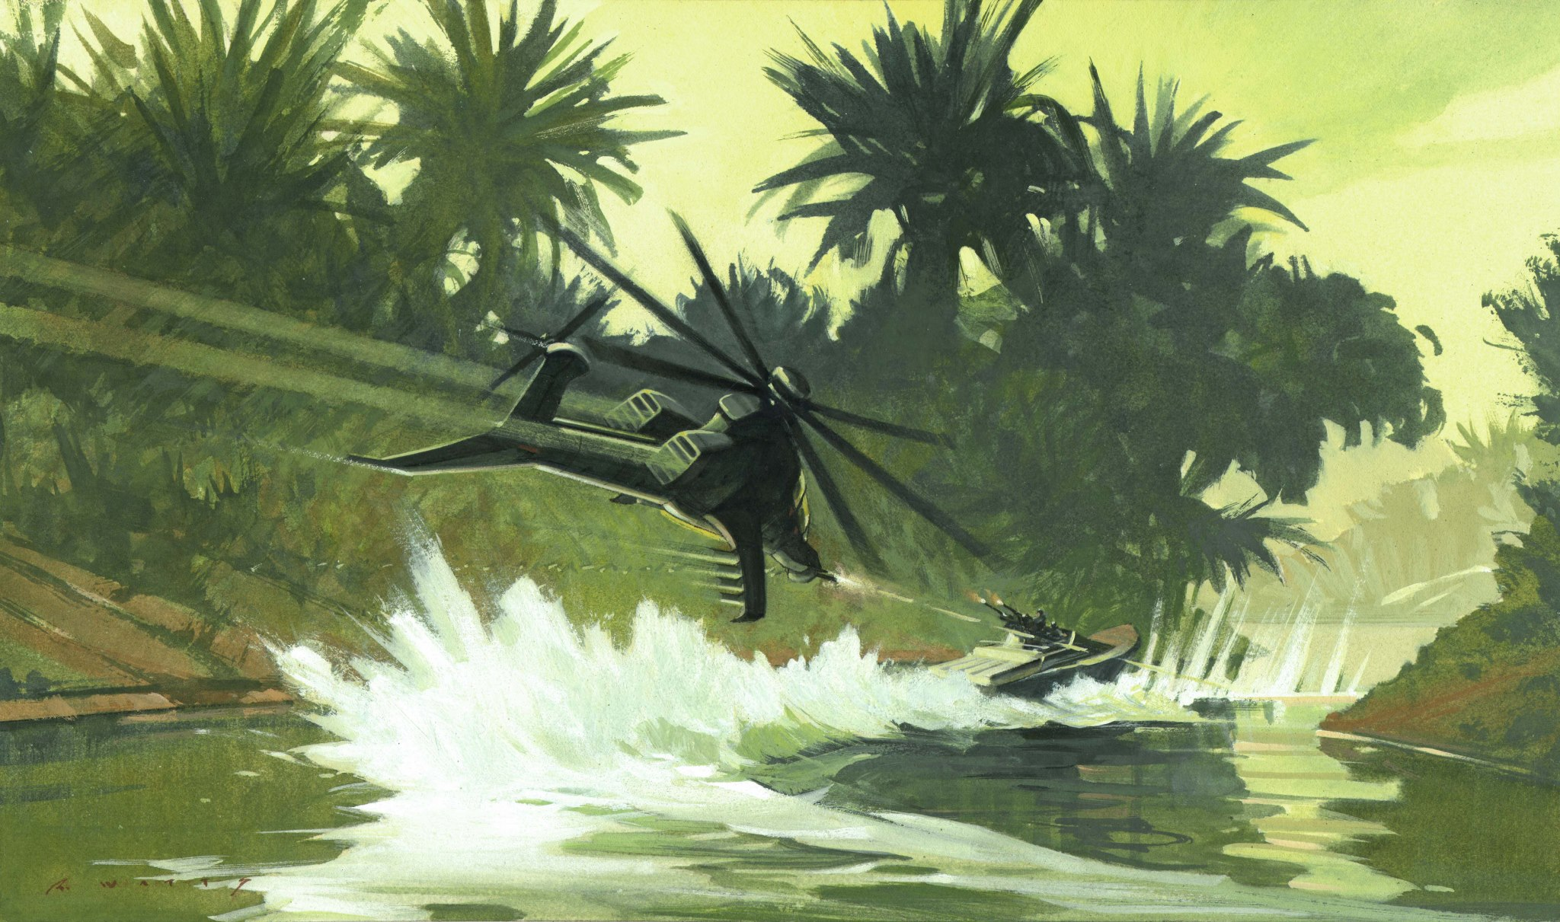
Concept Art – Tropical Environment

Slide 10
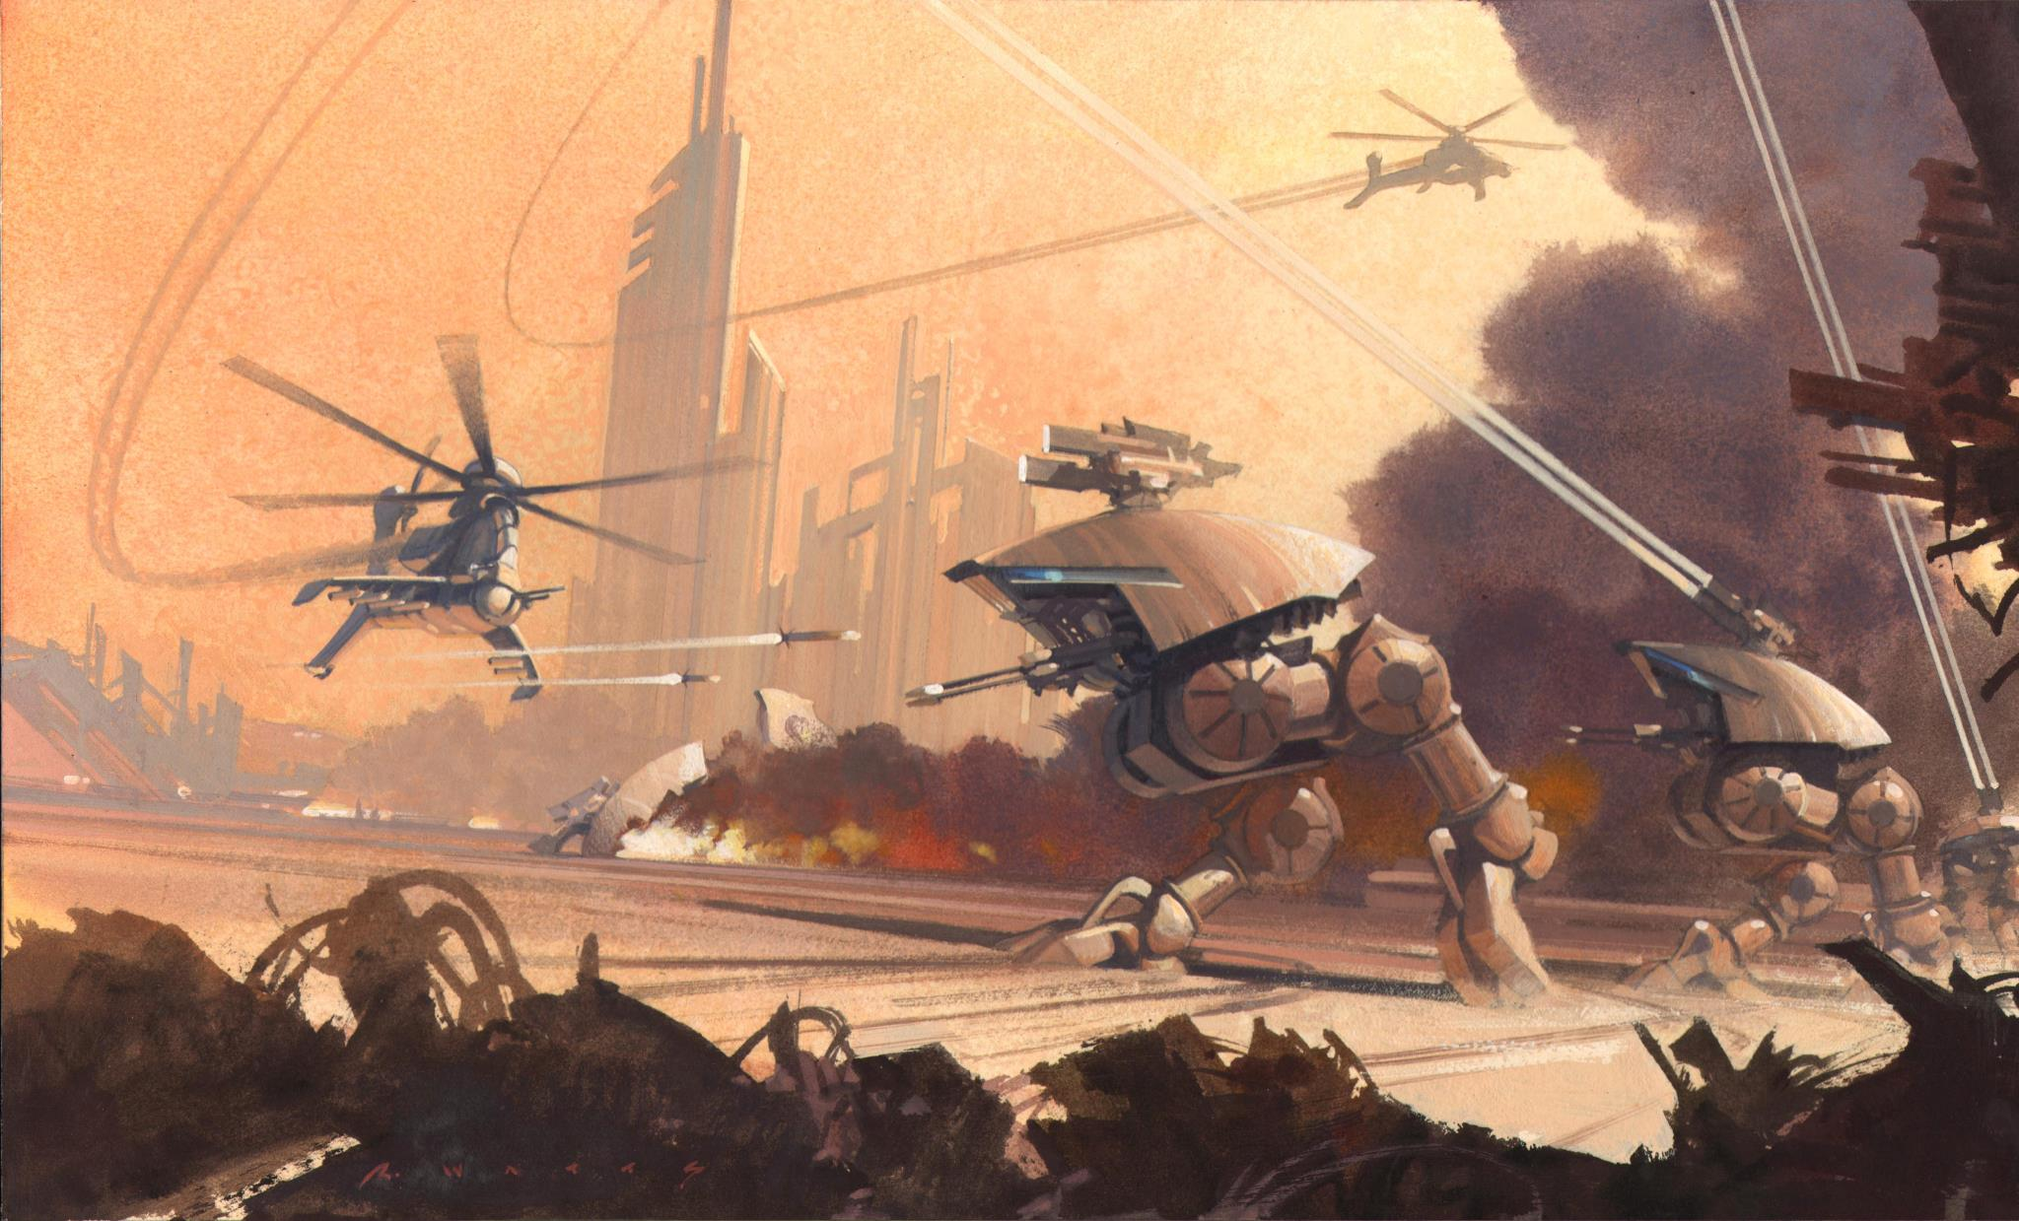
Concept Art – Mechanized Robots

Slide 11
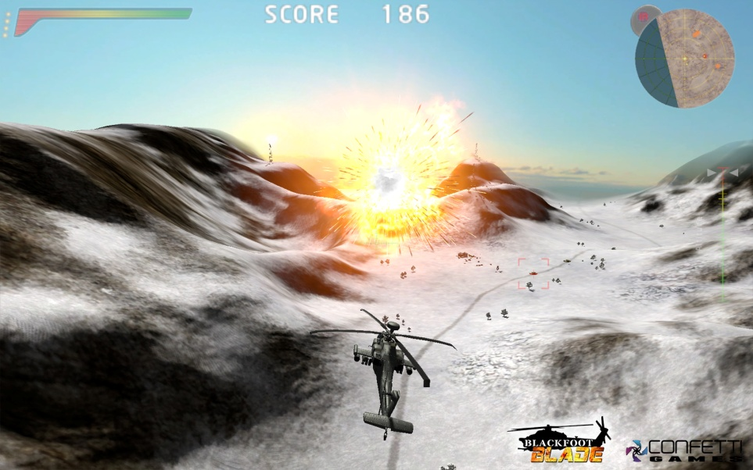
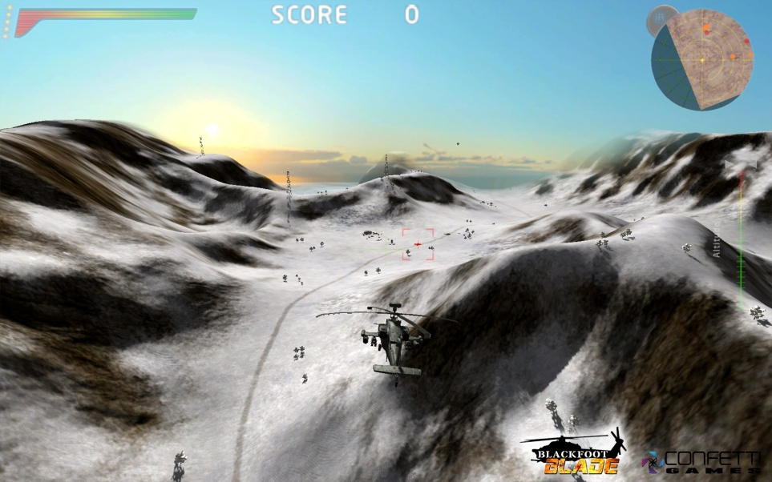
Blackfoot Blade!

Slide 12
Technology
Rendering: the game uses an older version of the rendering framework that will be used in the Winter class
Physics: the Bullet version in this rendering framework is used
Geometry: EmotionFX was licensed
Audio: fmod was licensed
Networking: our own networking layer was written

Slide 13
Requirements Rendering System
Decent hardware & mobile hardware -> lots of arithmetic instructions <-> limited memory bandwidth -> reduce streaming requirements -> local memory access
Game design: might require 24 hour cycle and/or everything is destructible -> no pre-computed light and shadow data

Slide 14
Requirements Rendering System
Art team workflow -> short iteration time
CG movie lighting and shadowing techniques -> lots of lights (100+ even at day time) and soft shadows (1000+) http://developer.amd.com/media/gpu_assets/GDC04_Yee_Hart_Preetham.pdf

Slide 15
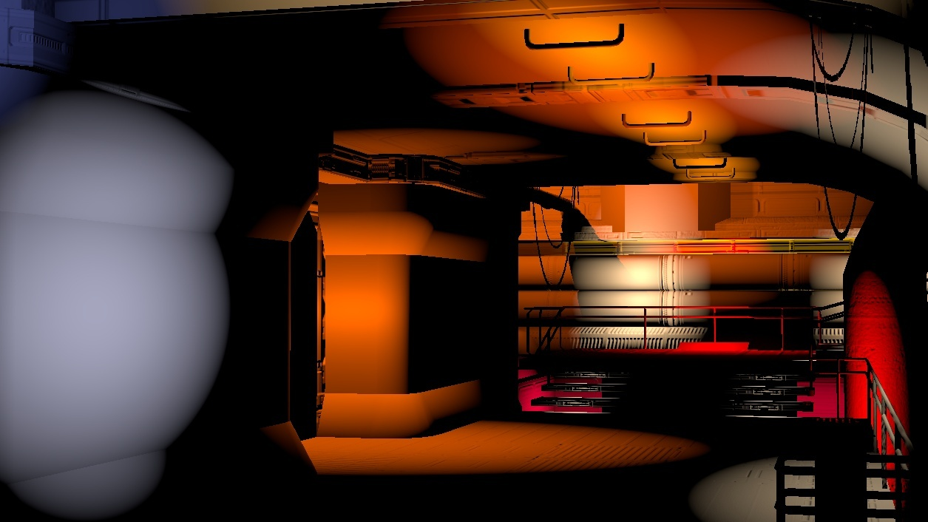
Notes:
overlapping lights

Slide 16
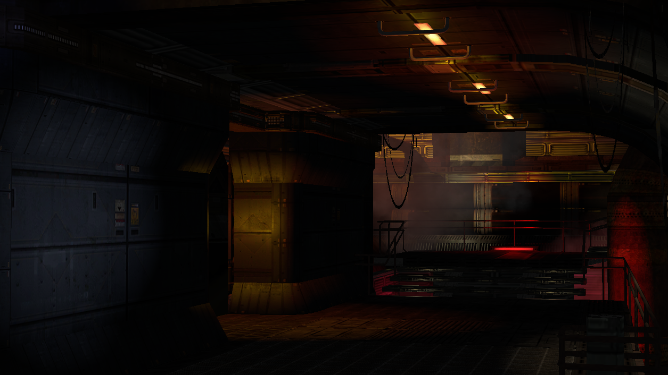
Notes:
dark but not black
layering
spilling yellow light, red from below

Slide 17
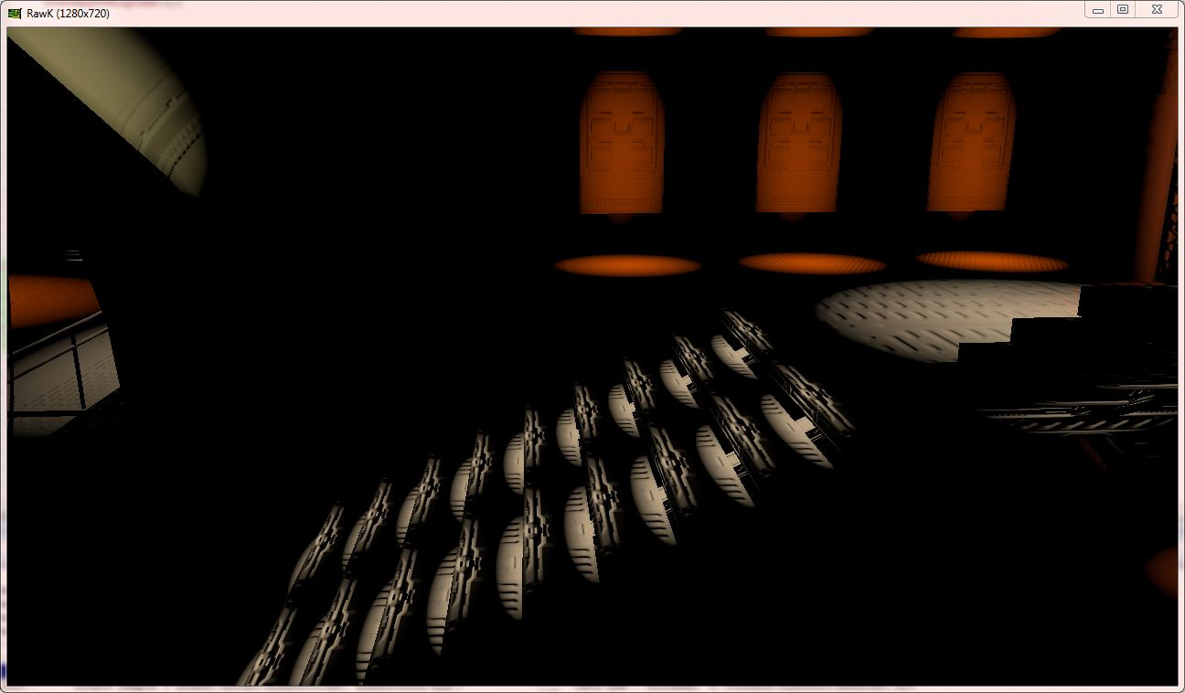

Slide 18
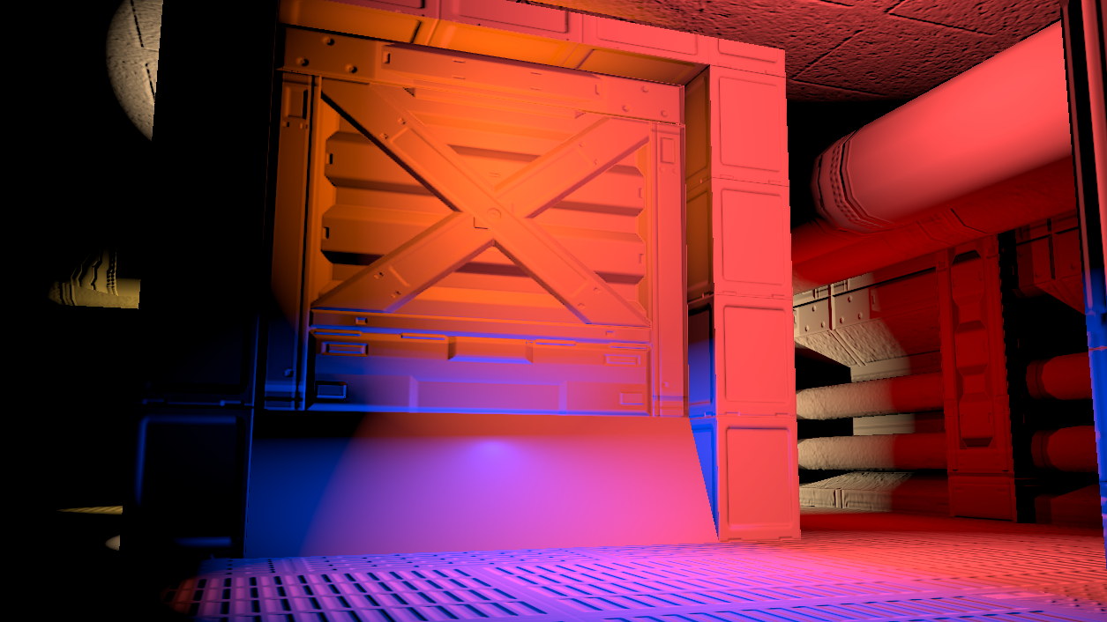

Slide 19
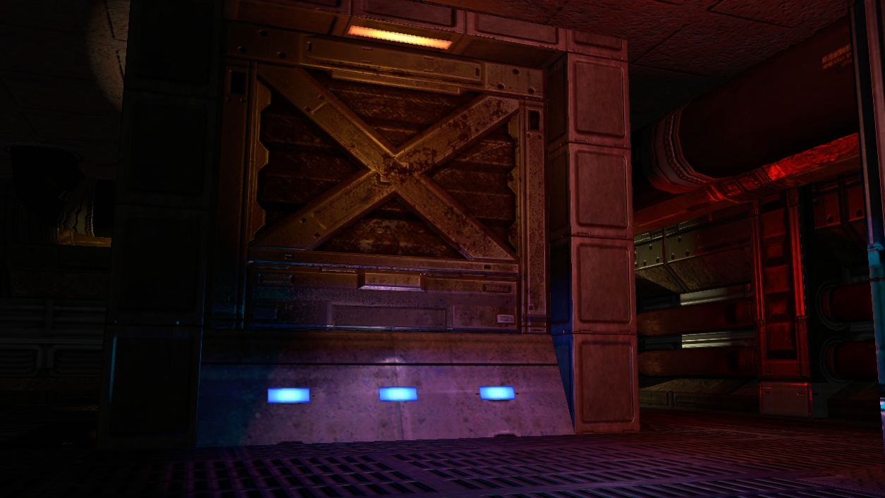

Slide 20
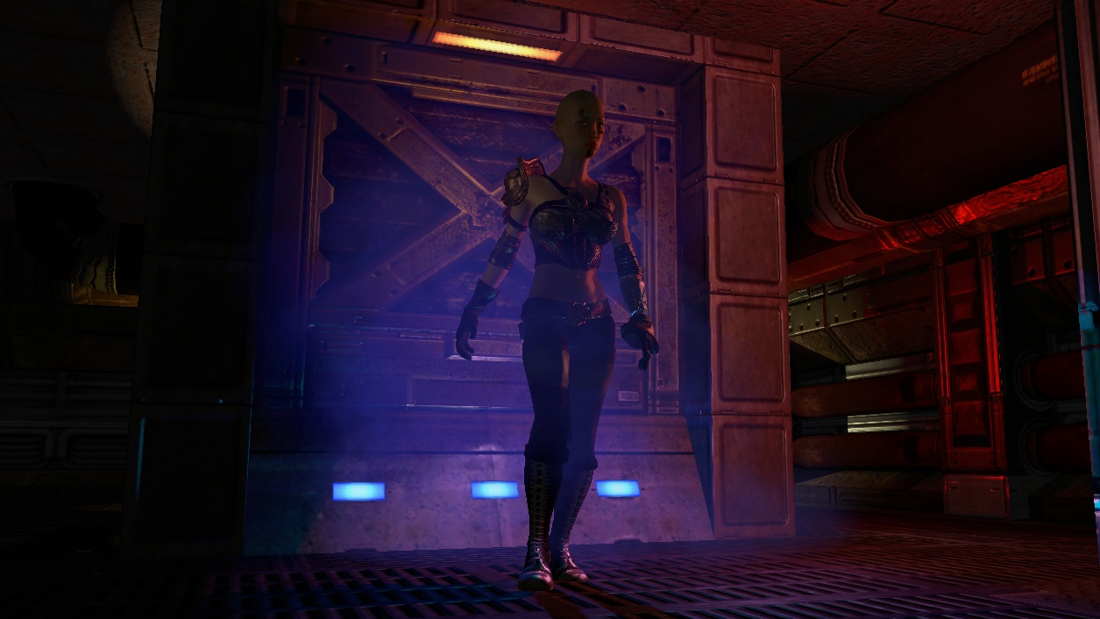

Slide 21
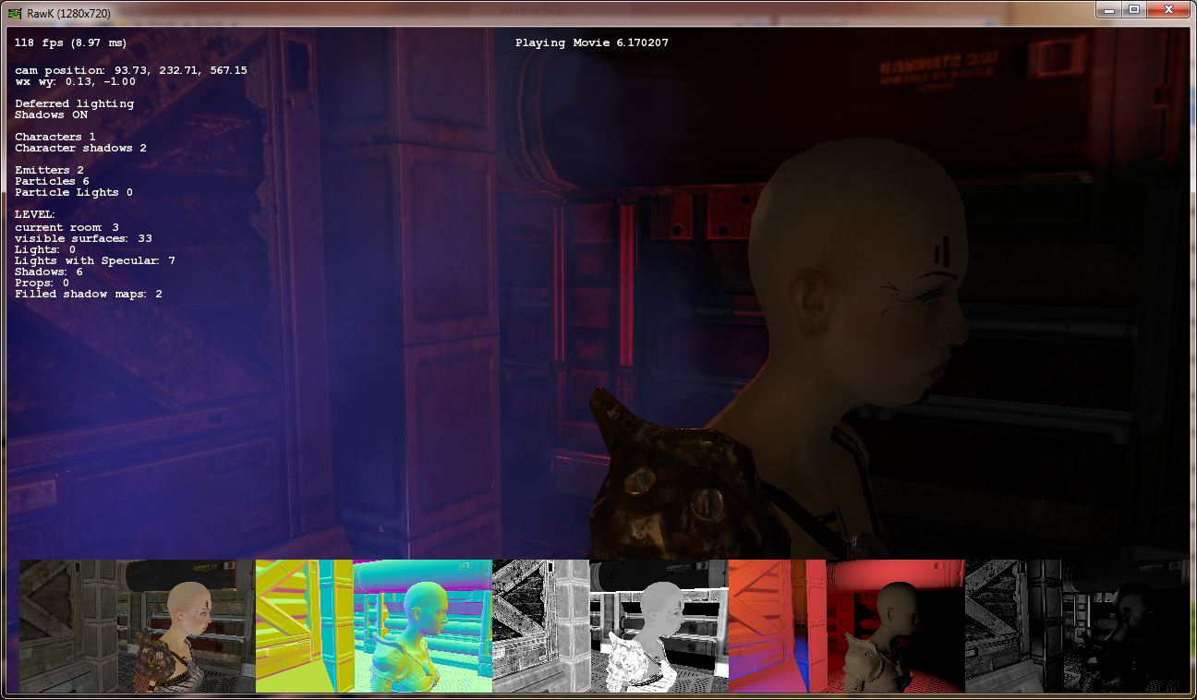

Slide 22
Lights: Deferred Lighting

Slide 23
Lights: Deferred Lighting
Confetti setup: (similar to S.T.A.L.K.E.R: Clear Skies [Lobanchikov])
Geometry pass: fill up normal + spec. power and depth buffer and a color buffer for the ambient pass
Lighting pass: store light properties in light buffer
Ambient + Resolve (MSAA) pass: fetch light buffer use its content as diffuse and specular content and add the ambient term while resolving into the main buffer

Slide 24
Shadows
Requirement: lots of lights require lots of shadows -> need to render lots of shadows fast and cache them

Slide 25
Shadows
In a game: many shadows to consider
Cloud shadows: just projected down
Character self-shadowing : those are optional shadows with their own frustum that is just around the bounding boxes
Sun shadows: Cascaded Shadow Maps
Shadows from point, spot and other light types

Slide 26
Shadows
Ellipsoidal Lights with Cube Map Shadows -> similar to a point light but has 3D attenuation vector
For example the area that the light affects can be ellipsoidal

Slide 27
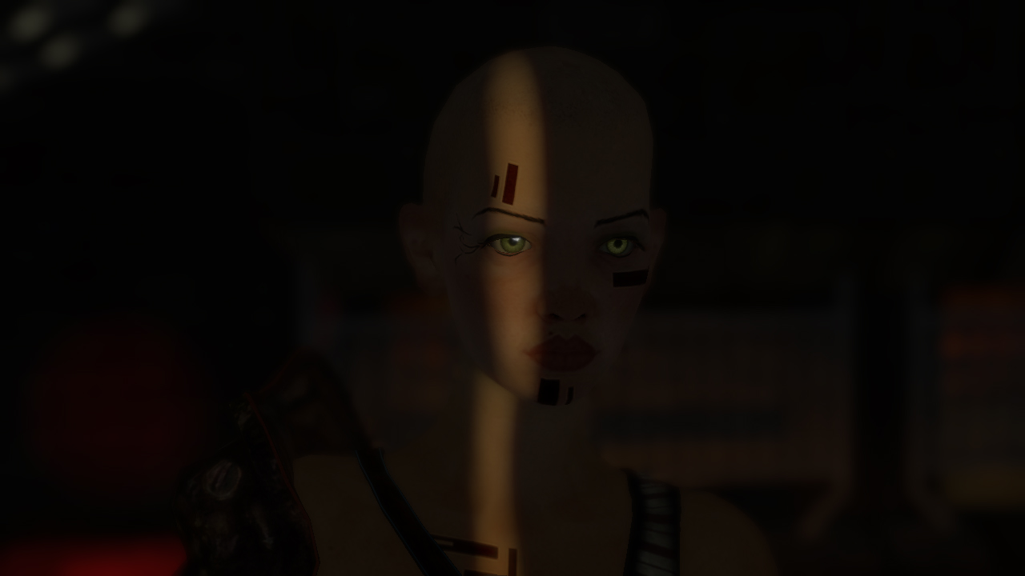
Shadows

Slide 28
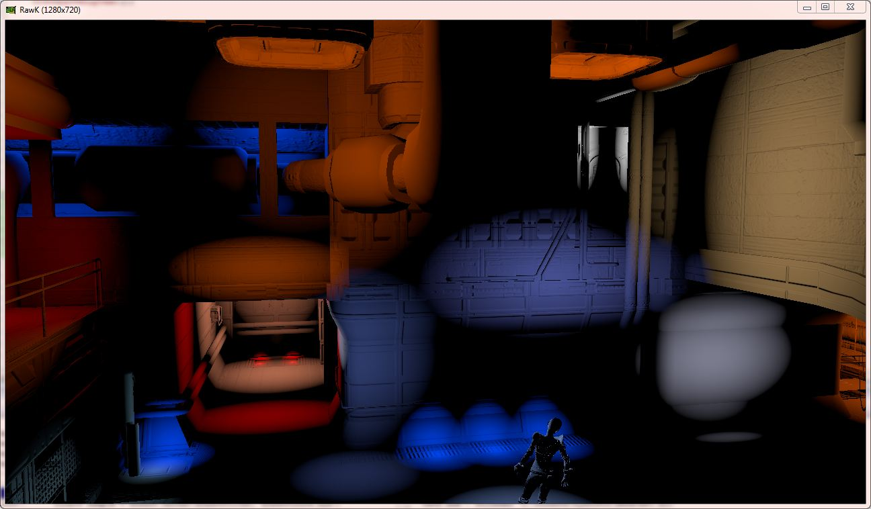
Shadows

Slide 29
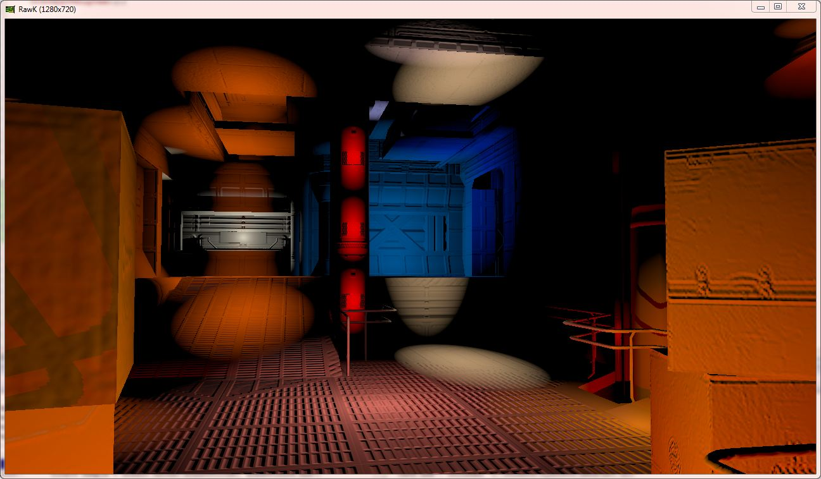
Shadows

Slide 30
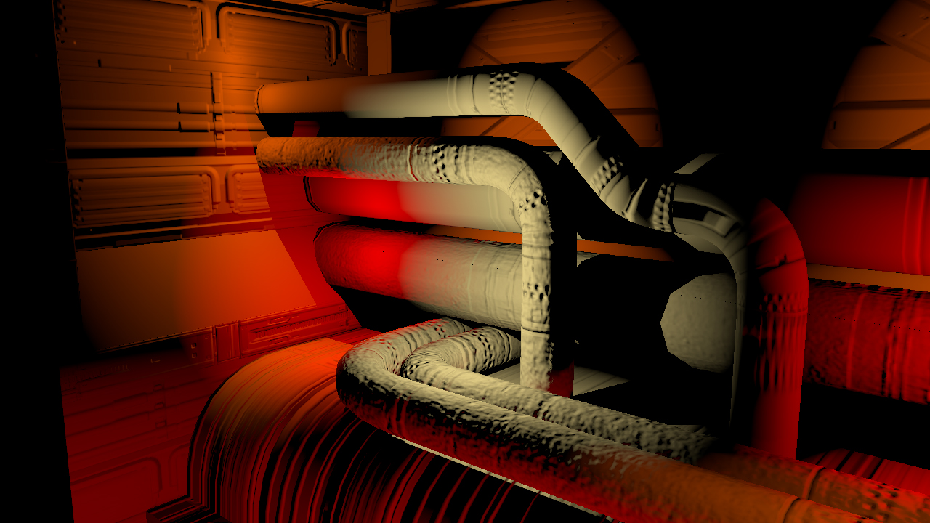
Shadows

Slide 31
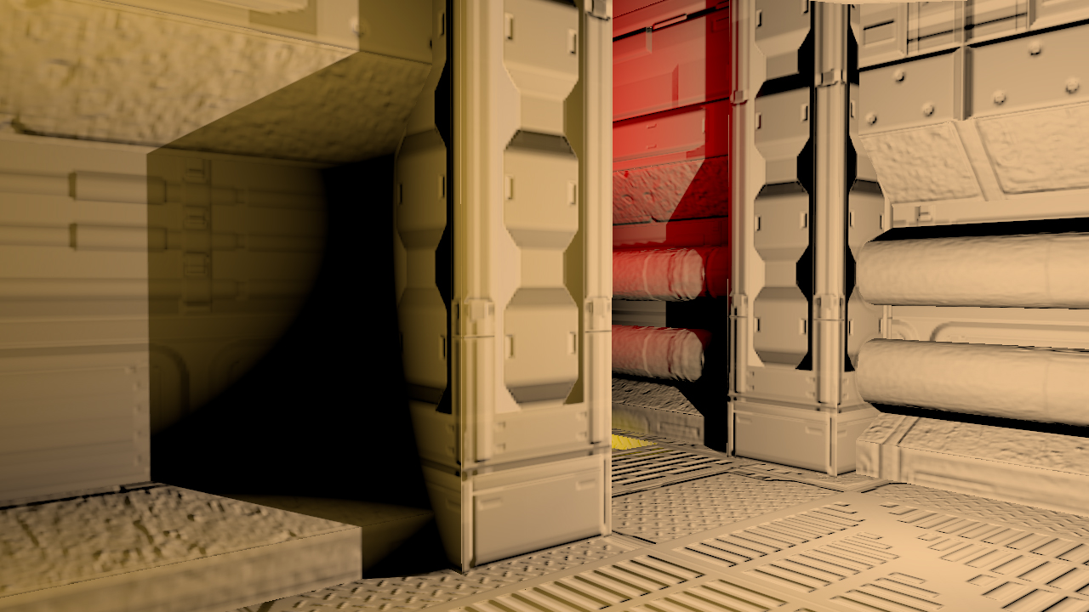
Shadows

Slide 32
Shadows
Mostly four areas of challenge
Shadow Rendering
Shadow Caching
Shadow Bias value
Softening the Penumbra

Slide 33
Shadow Rendering
Shadow Rendering
Cube shadow maps -> more even error distribution than Dual-Paraboloid Shadow Maps

Slide 34
Shadow Rendering
Performance:
DirectX 10+ geometry shader helps to render into cube shadow maps in one pass
Modern DirectX 11 AMD GPUs: -> might be better to avoid the Geometry shader

Slide 35
Shadow Caching
Caching shadows is nice as long as you have enough memory
Use 16-bit cube shadow maps for memory
Caching Parameters:
Distance from shadow to camera
Size of shadow on screen
Is there a moving object in the area of the light / shadow?

Slide 36
Shadow Caching
Based on those parameters a cube shadow map is updated or not
Storing 100 256x256x6 16-bit cube maps is about 75 Mb
If this is still too much, caching needs to be restricted by distance and then maps are moved in and out into a linked list

Slide 37
Shadow Bias value
As long as the shadow map comparison for cube shadow maps is binary -> 0 / 1 the depth bias value won’t be correct for all six directions
Replace binary comparison with Exponential Shadow maps comparison

Slide 38
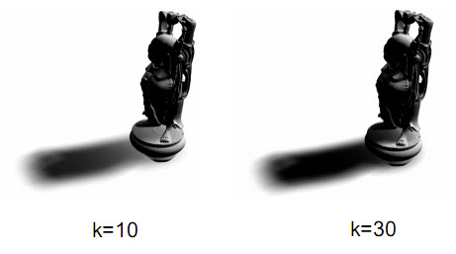
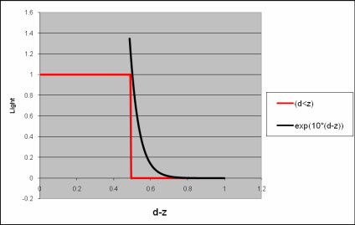
Shadow Bias value
Exponential Shadow Maps [Salvi]
float depth = tex2D(ShadowSampler, pos.xy).x;
shadow = saturate(2.0 - exp((pos.z - depth) * k));
Approximate step function (z-d> 0) by
exp(k*(z-d)) = exp(k*z) * exp(-k*d)
Good overview on the latest development in [Bavoil]

Slide 39
Softening Penumbra
ESM will soften the penumbra

Slide 40
Shadows

Slide 41
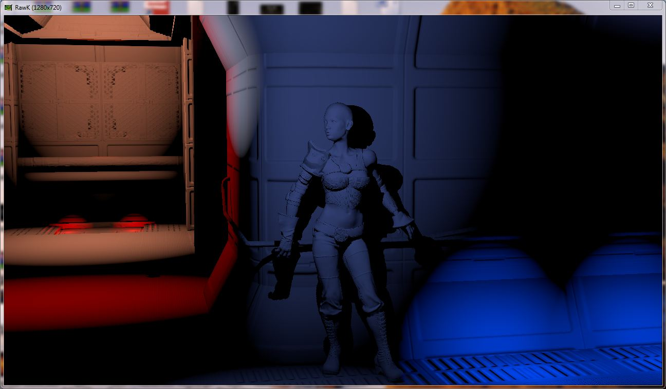
Shadows

Slide 42
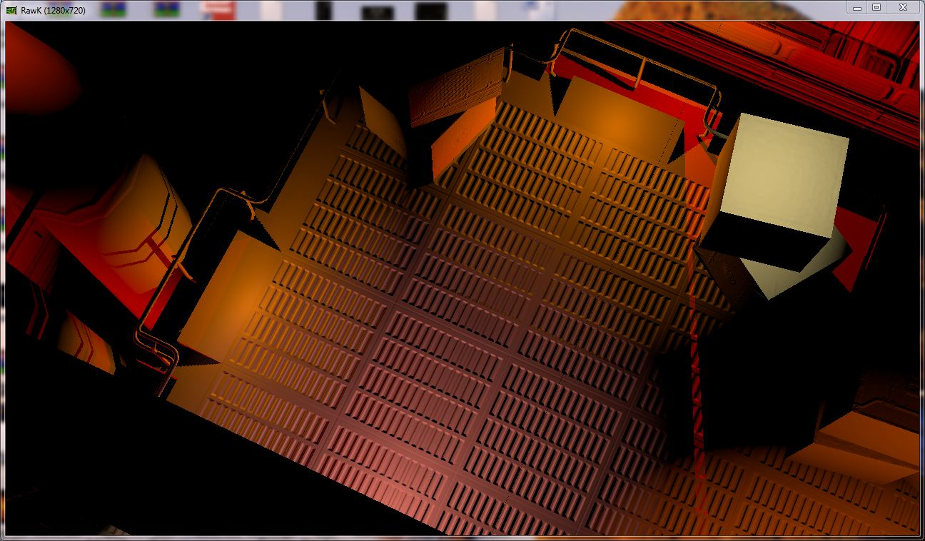
Shadows

Slide 43
Features to Add
Populate levels: Vegetation, Buildings
New rockets (three different rockets)
New enemy types/behaviors: tanks that move and fast moving air enemies (drones)
Cooperative Multiplayer
iOS / Android / Steam support
Tropical Island
Mech Warrior
QA / Optimizations

Slide 44
Blackfoot Blade!
Facebook page: http://www.facebook.com/ConfettiGames
Confetti Games website http://www.confettigames.com/
Gameplay trailers: https://vimeo.com/user14591122/videos

Slide 45
Contact
wolf@confettigames.com or wolf@conffx.com

Slide 46
References
[Bavoil] Louis Bavoil, “Advanced Soft Shadow Mapping Techniques”, http://developer.download.nvidia.com/presentations/2008/GDC/GDC08_SoftShadowMapping.pdf
[Engel] Wolfgang Engel, “Light Pre-Pass -Deferred Lighting: Latest Development- “, Advanced Rendering Day, SIGGRAPH 2009, http://www.bungie.net/News/content.aspx?link=Siggraph_09
[Lobanchikov] Igor A. Lobanchikov, “ GSC Game World‘s S.T.A.L.K.E.R : Clear Sky – a showcase for Direct3D 10.0/1”, http://developer.amd.com/gpu_assets/01GDC09AD3DDStalkerClearSky210309.ppt

